Slide 1
Hepatocellular carcinoma in The Cancer Genome Atlas(TCGA)

Slide 2
Agenda
Introduction to The Cancer Genome Atlas(TCGA)
Analysis Of Data Using Tools of TCGA
Using R language to access TCGA

Slide 3
Introduction
The Cancer Genome Atlas (TCGA) is a public funded project that aims to catalogue and discover major cancer-causing genomic alterations to create a comprehensive "atlas" of cancer genomic profiles. So far, TCGA researchers have analyzed large cohorts of over 30 human tumors through large-scale genome sequencing and integrated multi-dimensional analyses. Studies of individual cancer types, as well as comprehensive pan-cancer analyses have extended current knowledge of tumorigenesis. A major goal of the project was to provide publicly available datasets to help improve diagnostic methods, treatment standards, and finally to prevent cancer.

Slide 4
TCGA Tools
cBioPortal
Provides visualization, analysis, and download of large-scale cancer genomics data sets
Firehouse
A suite of tools and pipelines developed for processing and analyzing various types of large-scale genomic and proteomic data.
SurvNet
A web-based tool for identifying network-based biomarkers that correlate with patient survival data. (MD Anderson Cancer
1
2
3

Slide 5
The First Tool CBioPortal
How to access data in CBioPortal ?
First go to the following link -> https://www.cbioportal.org/
Then click on the Liver option.
You will see multiple dataset.
Then click on Liver Hepatocellular Carcinoma (TCGA, Firehose Legacy).
Then click on View clinical and genomic data of this study .

Slide 6
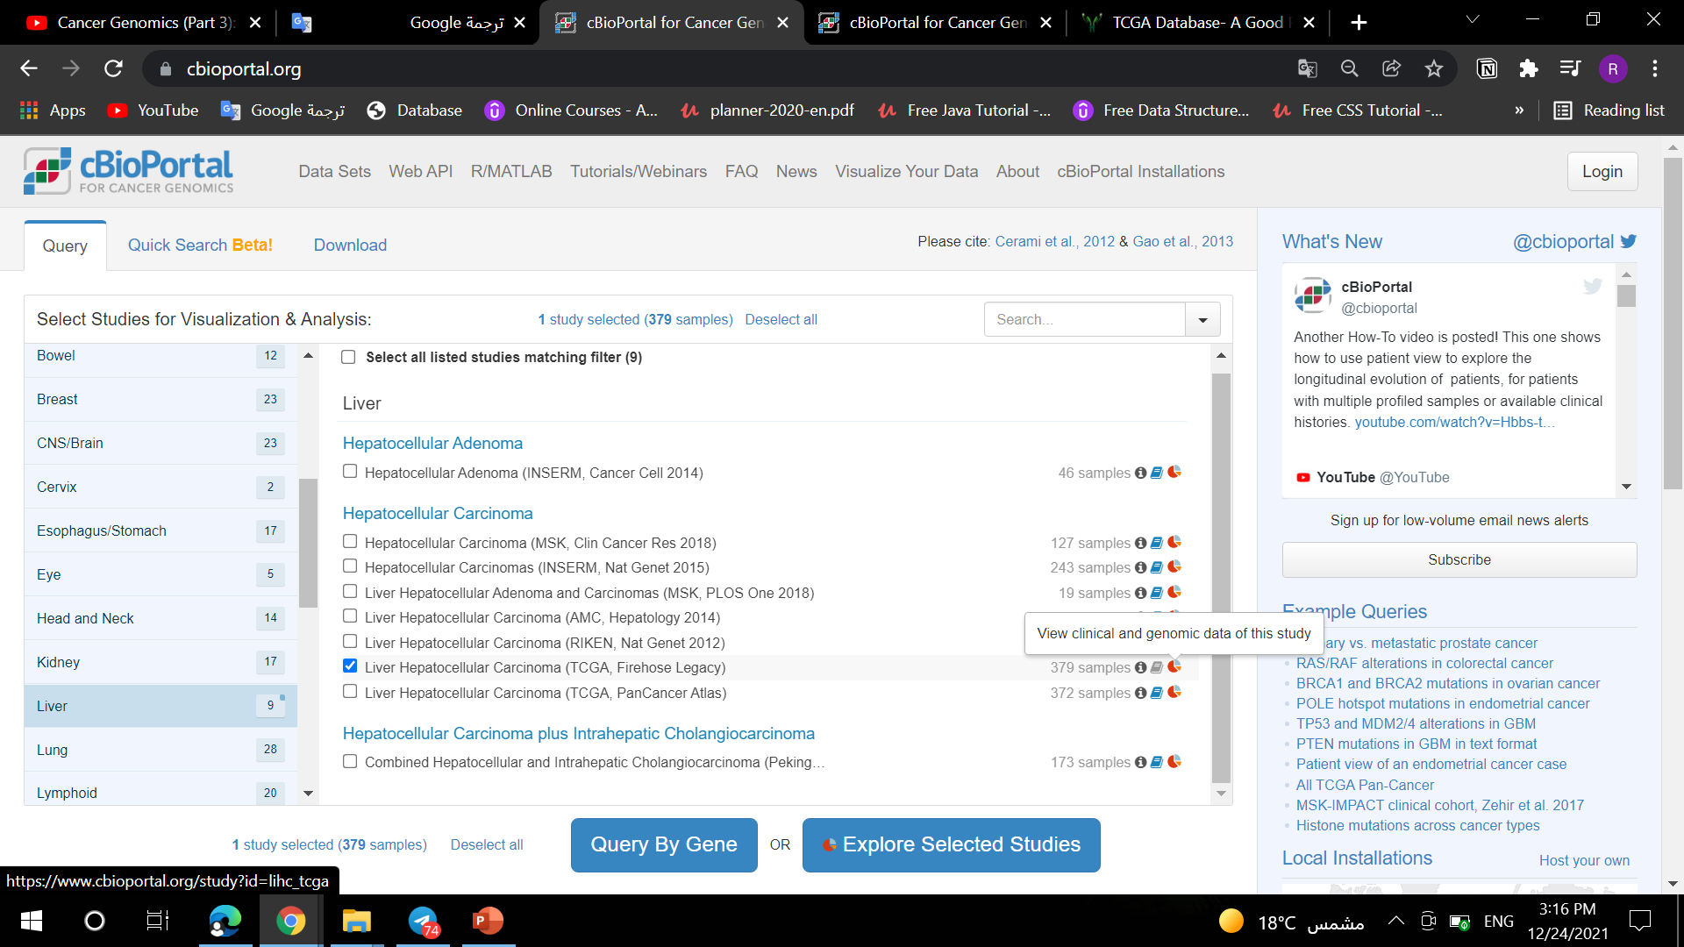

Slide 7
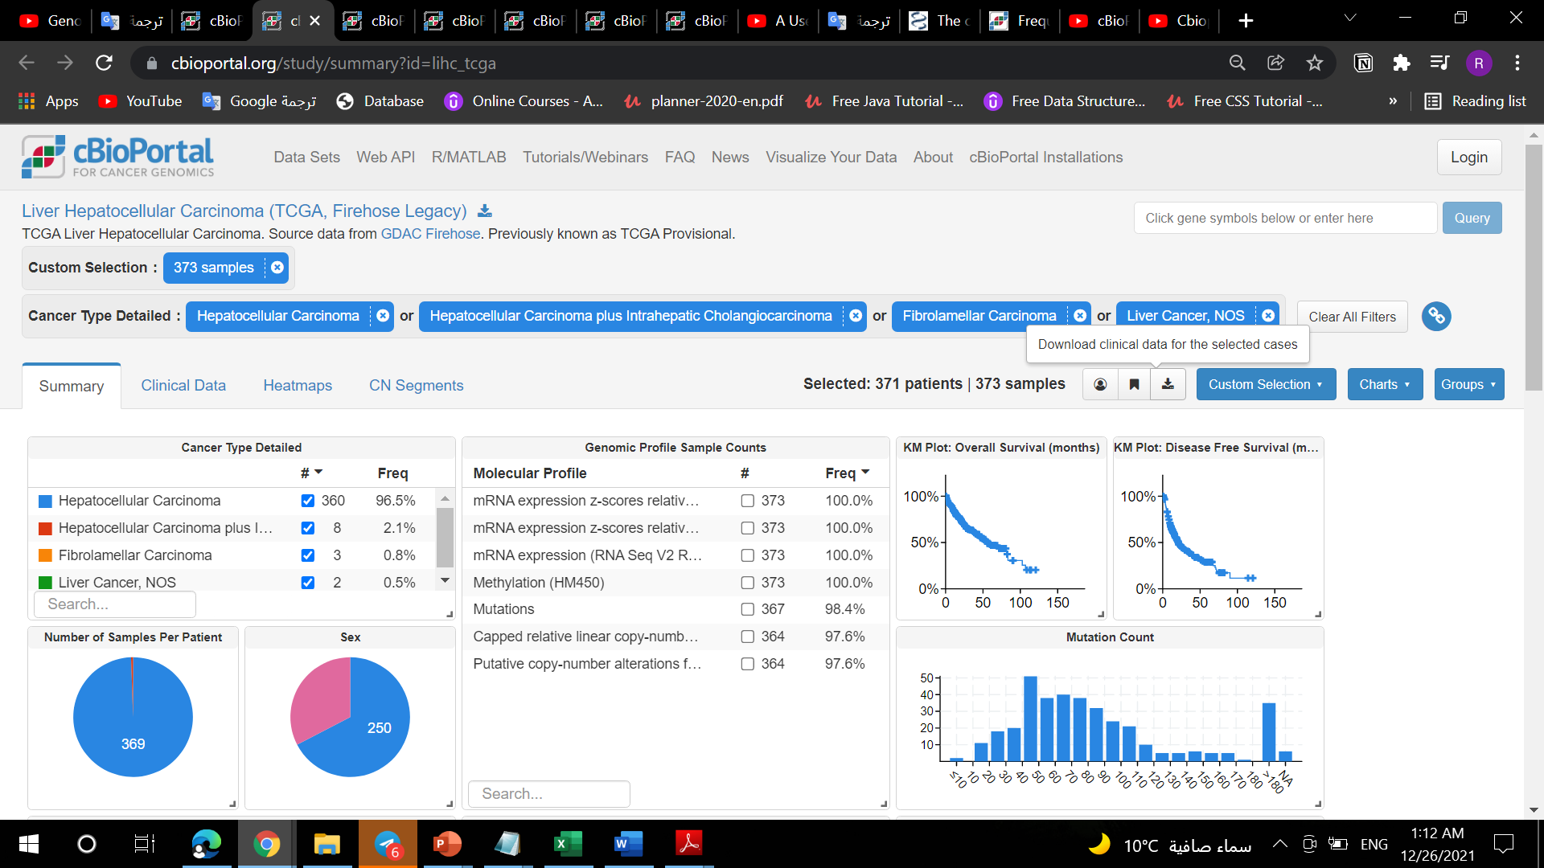
How to download data ?
First identify all types of cancer that will be used in the analysis
Then click on Download clinical data for the selected cases
It will download all clinical data for 371 patients and 373 samples

Slide 8
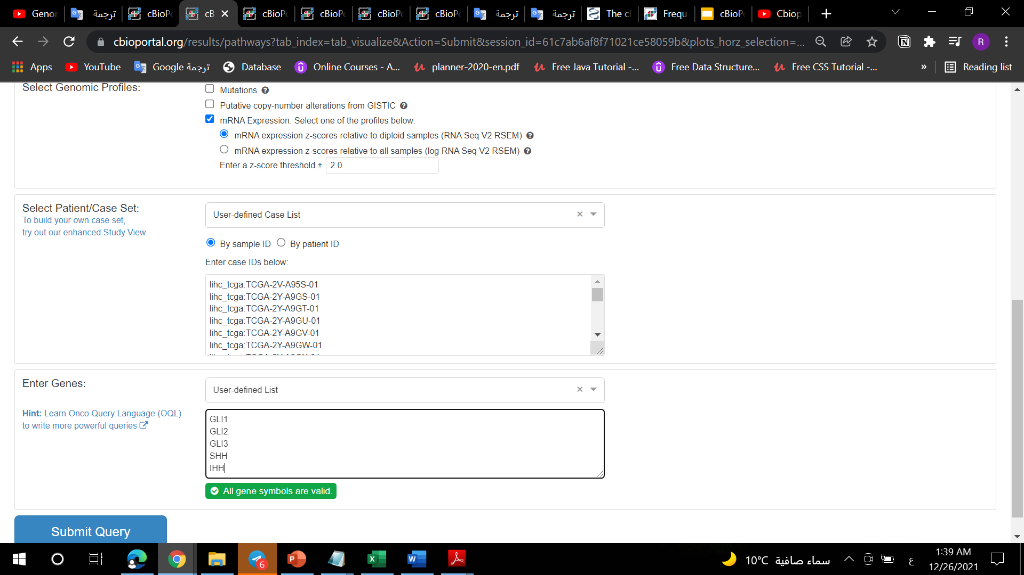
We will query the gene expression of 5 genes in hepatocellular carcinoma
Select mRNA expression in genomic profiles.
In Select Patient/Case Set we will enter sample Id from the previously downloaded data file.
Then enter the five genes .
Then click submit query.

Slide 9
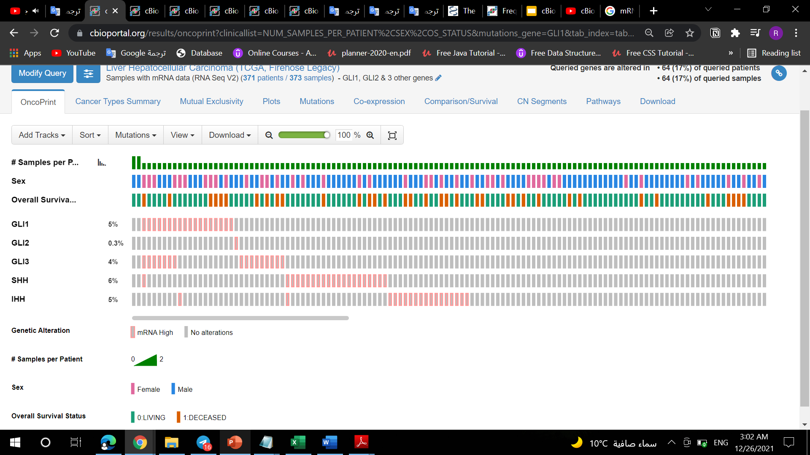
In OncoPrint we will notice :
Each sample is a column and we have 373 sample and 371 patient ,There is a recurrence in samples two patients.
Each gene is a row and SHH is the highest expressed gene at 6% and GLI2 is the lowest at 0.03%
In Overall Patient Survival Status ,The green color indicates that the patient is alive, and the orange color indicates the death of the patient

Slide 10
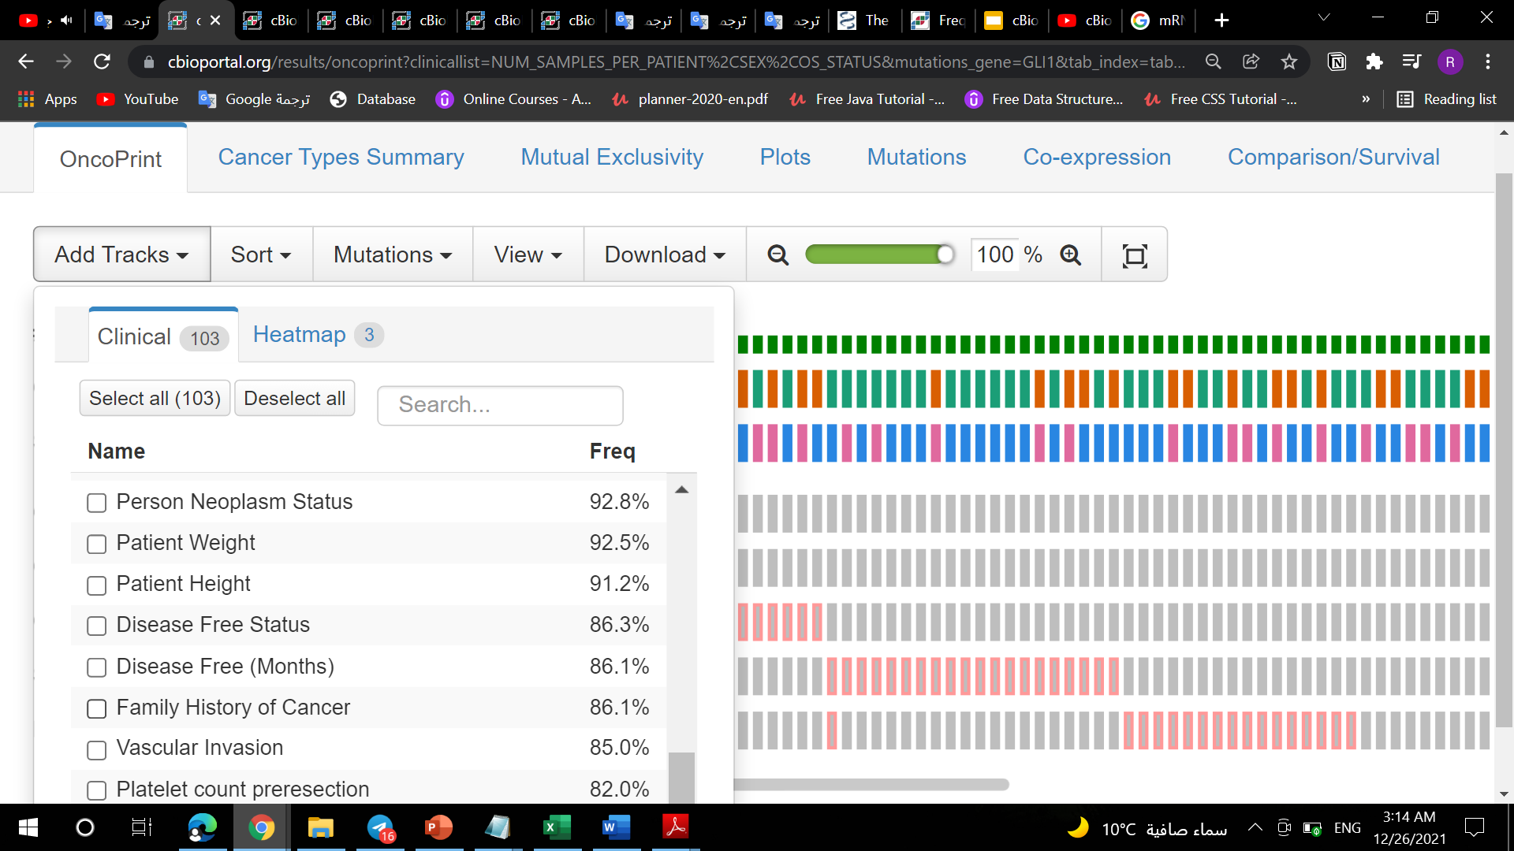
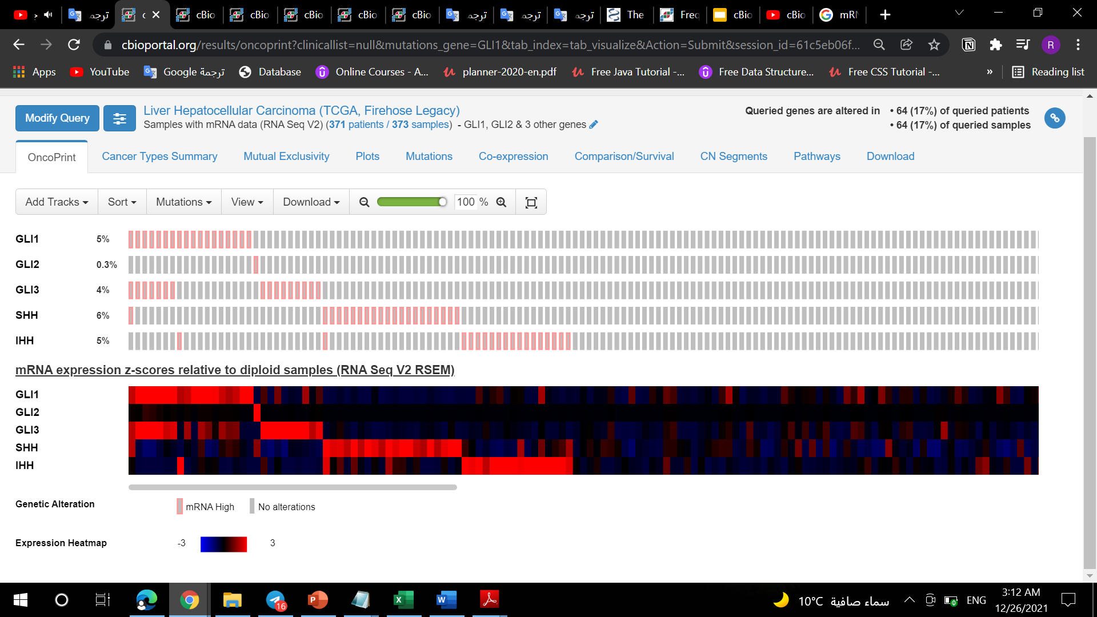
In Add Tracks ,we can add a lot of track about clinical data such as Diagnosis Age, Family History of Cancer , Disease Free Status ,Patient Weight and Patient Height
We can add a heatmap that indicates the visualization of mRNA expression rates for single genes GLI1,GLI2,GLI3,IHH and SHH

Slide 11
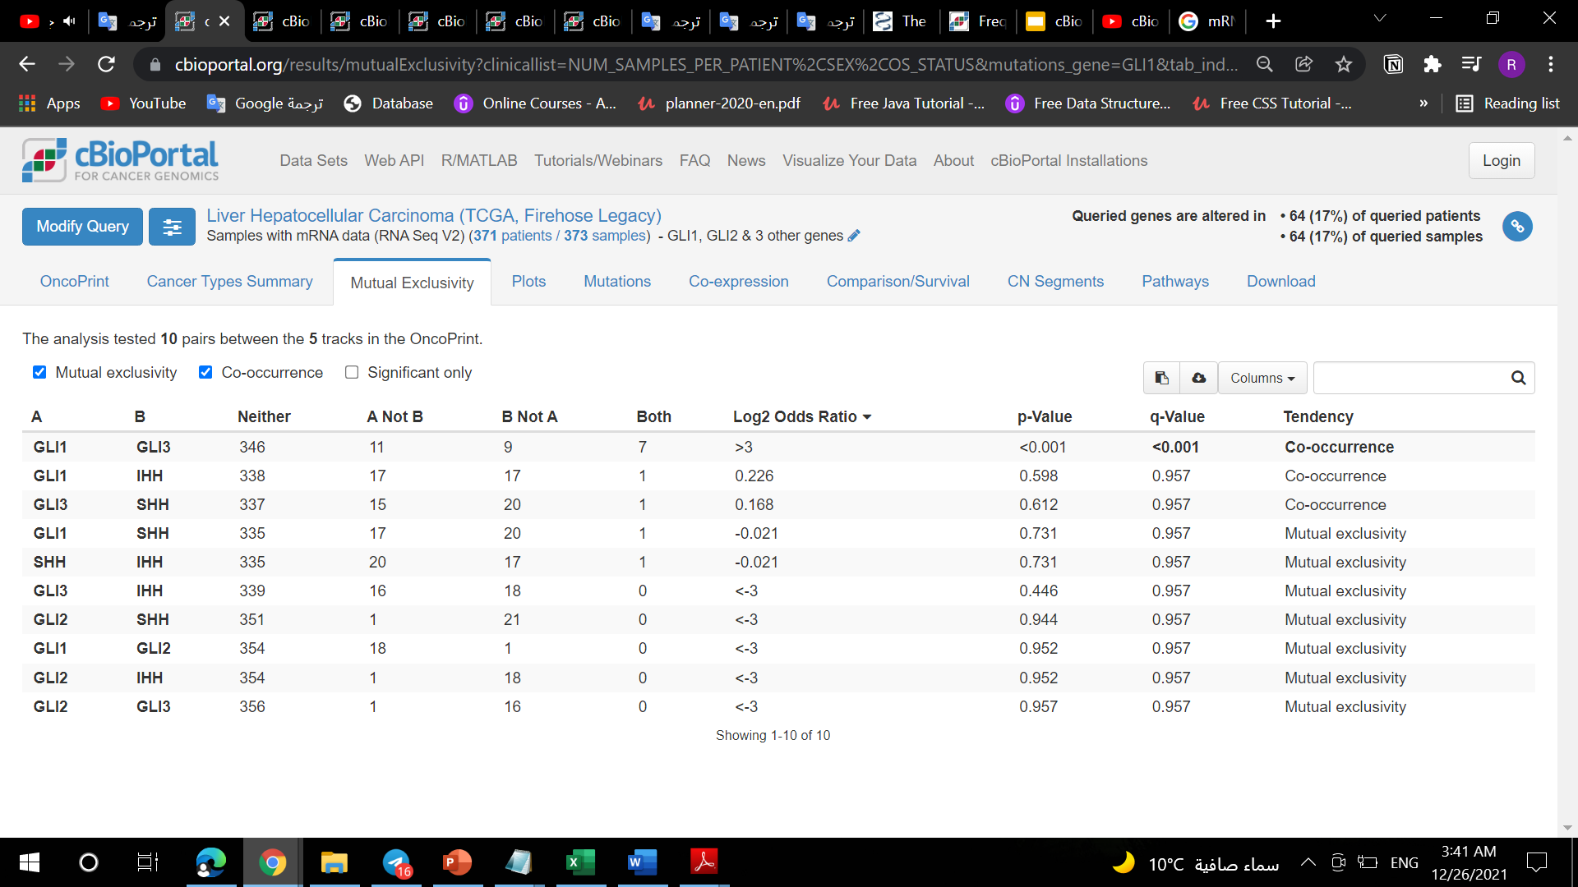
In Mutual Exclusivity :
All pairwise of genes analyzed for mutual exclusivity or co-occurrence in the queried samples.
We notice that GLI1 and GLI3 show significant association of co-occurrence each other this one combination showed the p-value that less than 0.05.
In the column Log2 Odds Ratio : positive value suggests that alterations in these genes co-occur in the same samples, while a negative value suggests that alterations in these genes are mutually exclusive and occur in different samples.

Slide 12
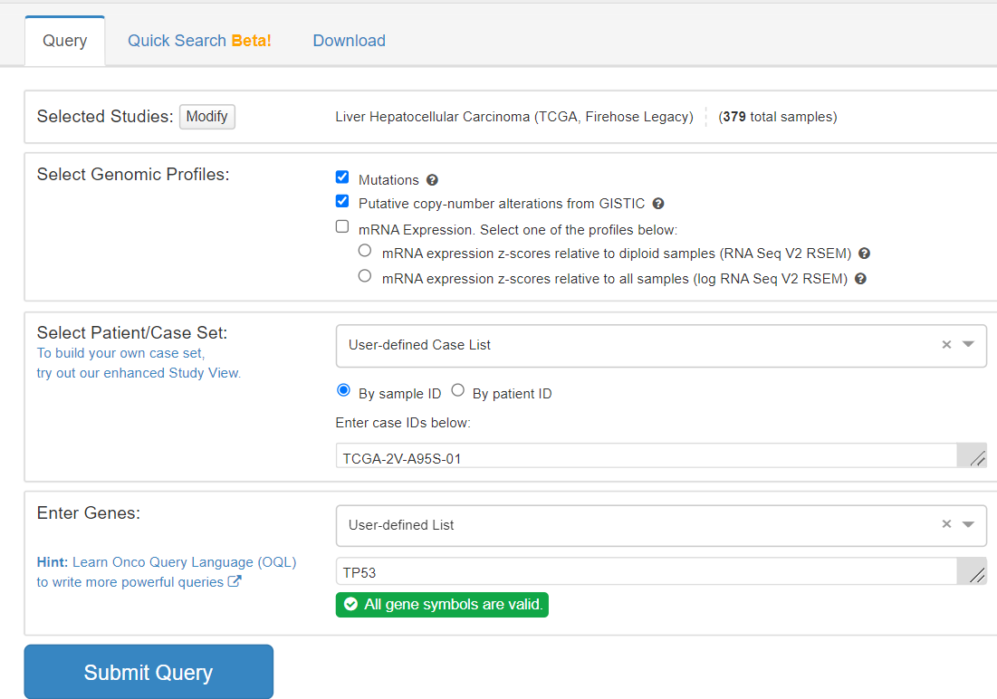
Now we will Single nucleotide polymorphism analysis of TP53 gene in LIHC:
We will return to the home page.
Then we will select Mutations and Putative copy number alterations in genomic profiles.
In Select Patient/Case Set we will enter sample Id from the previously downloaded data file.
Then enter TP53 gene .
Then click submit query.

Slide 13
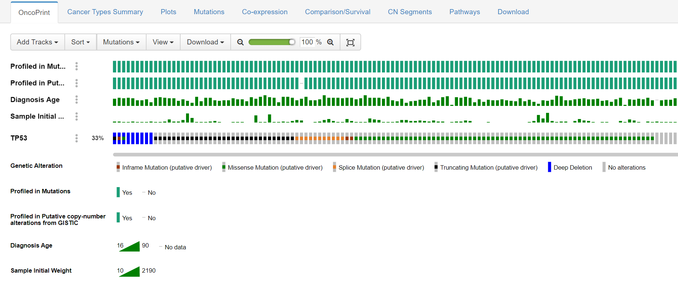
In OncoPrint we will notice :
The TP53 gene affected by 4 types of mutations (Missense, Splice, Truncating and Inframe) and 1 type of DNA copy number modifications.
The TP53 gene is present in the samples with a percentage of 33%.
We note that the patients' ages range from 16 to 90 years, and this is the age of the patient's diagnosis
We also note that the size of the tumor cancer sample ranges from 10 to 2190 grams.
In profiled in mutations and Putative copy number alterations the green color indicates that the sample had a mutation or alterations in general or not .

Slide 14
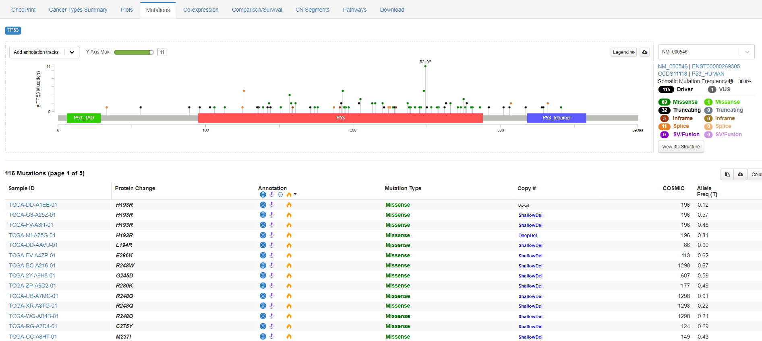
In Mutations we will notice :
The TP53 gene is affected by 116 mutations, resulting in 90 proteins.
Protein R249S has 11 mutations which is the highest number of mutations that could affects proteins.

Slide 15
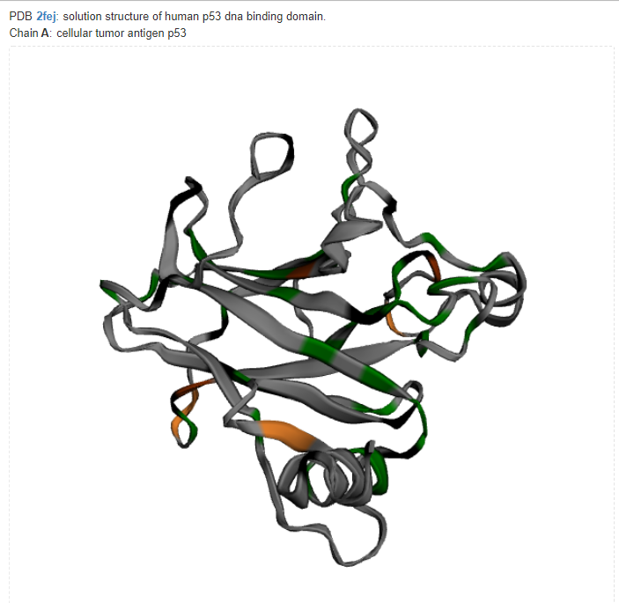
In Annotation showing the genetic mutation that occurred in the sample and what the role of the gene after the mutation and some information about the activity of the tumor.
When we click on the view of the 3D structure, we will see cellular tumor antigen p53 protein and its mutations in color green as Missense Mutations, color black as Truncating Mutations ,color brown as Inframe Mutations and color orange as Splice.

Slide 16
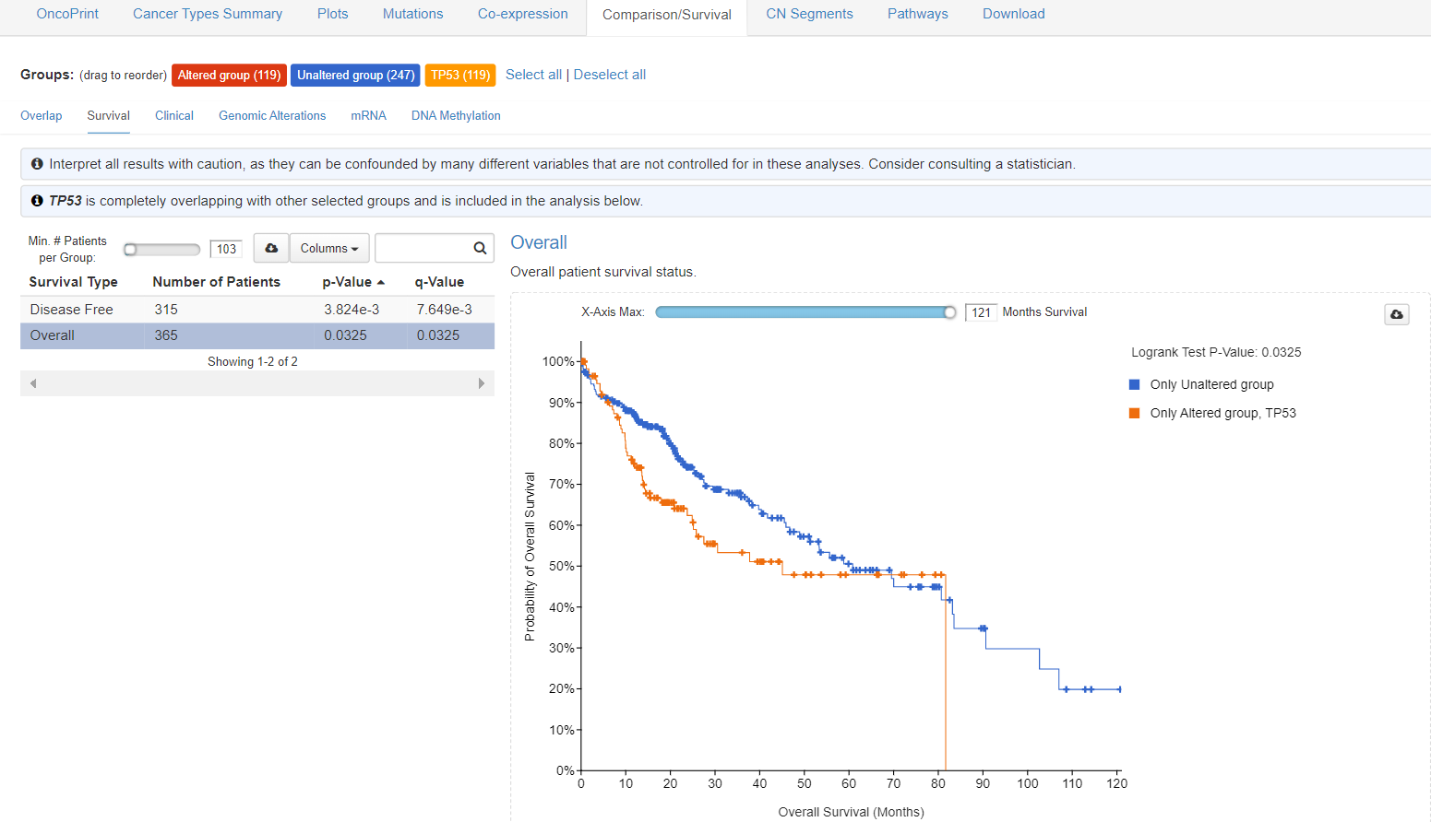
In Comparison/Survival we will notice :
As the number of months increases, the rate of recovery from the disease decreases, and therefore the death rate increases.
The maximum number of months patient can survive from altered group is approximately 80 months .

Slide 17
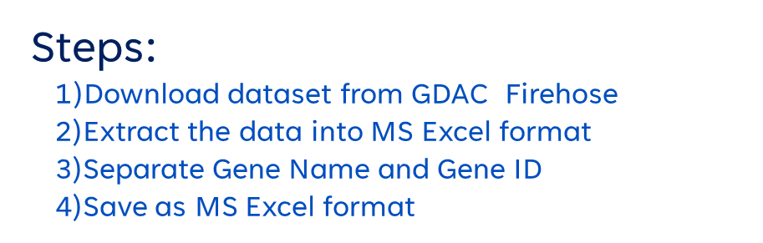
The Second Tool Firehouse

Slide 18
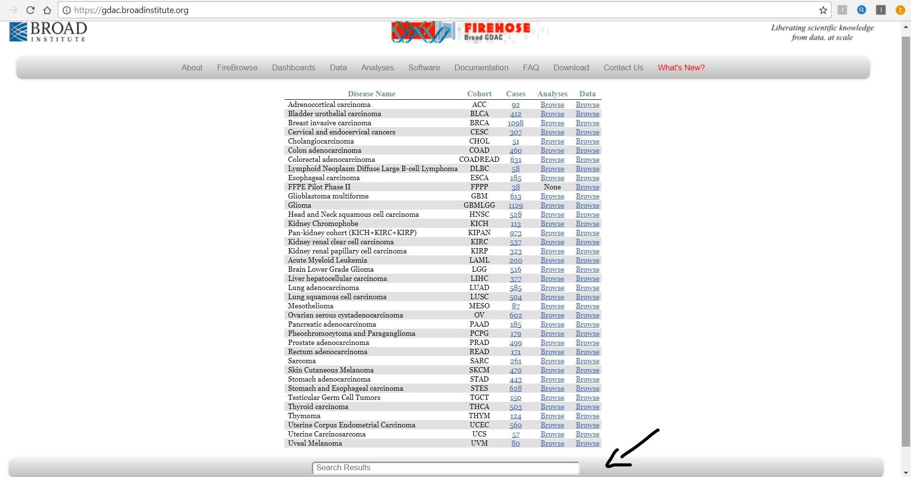
Download dataset from GDAC Firehose Choose the Disease Name or Type the Disease Name on the Search Results(Liver Hepatocellular carcinoma) Click on Browse.

Slide 19
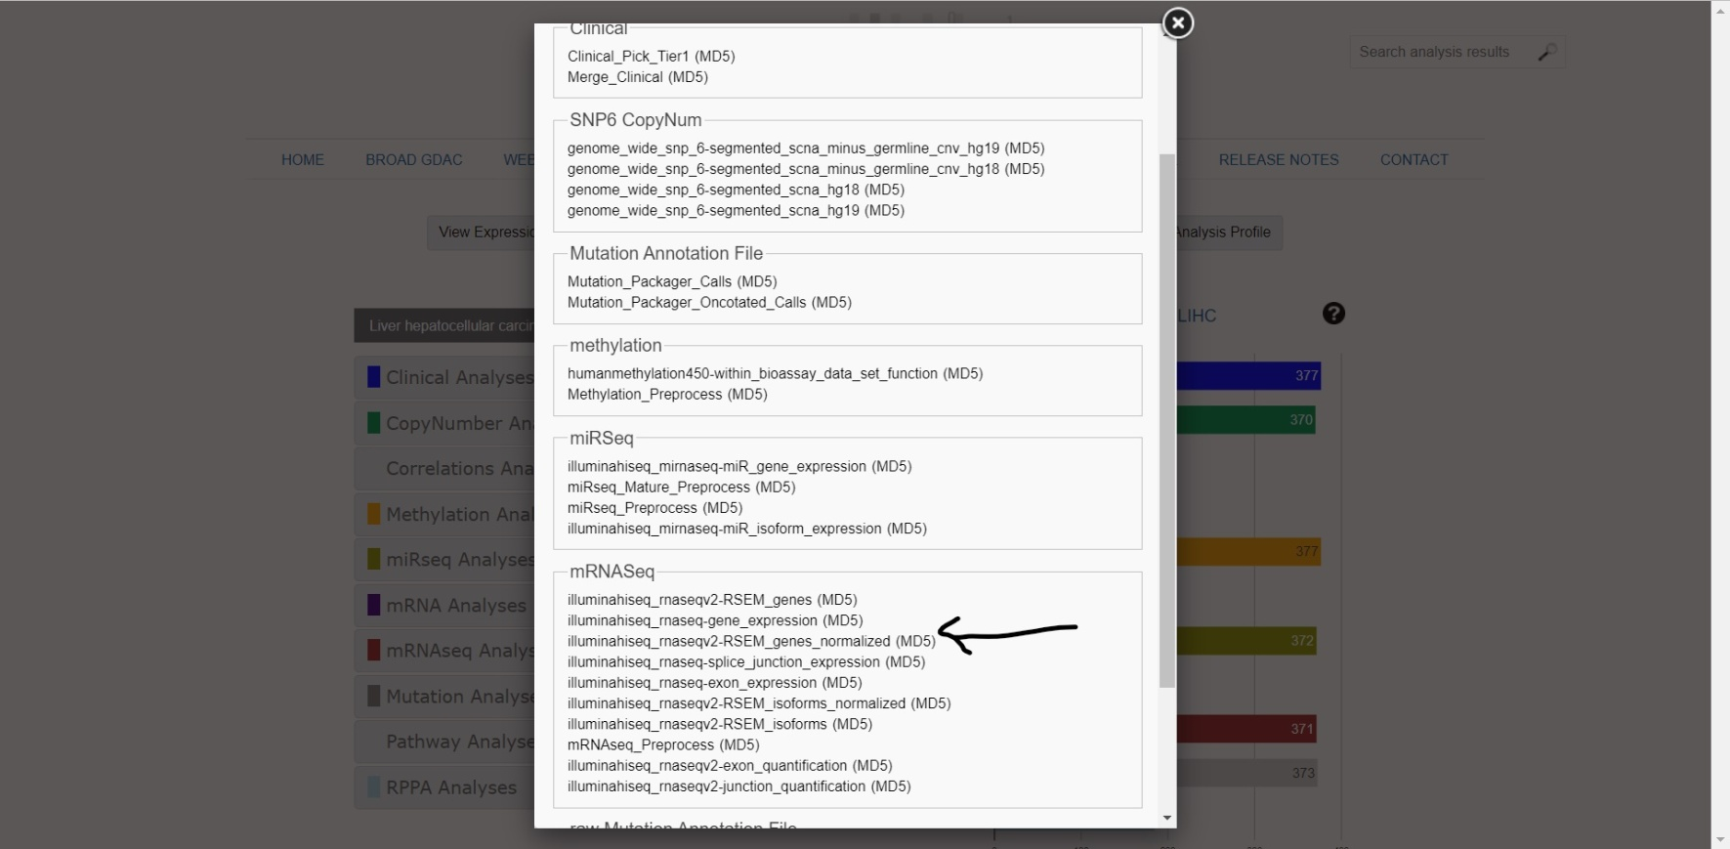
Choose what kind of Data you want to Download from the Archives(Clinical Analyses or Mutation Analyses or mRNAseq Analyses….) Download mRNAseq (RSEM Gene Normalized data)

Slide 20
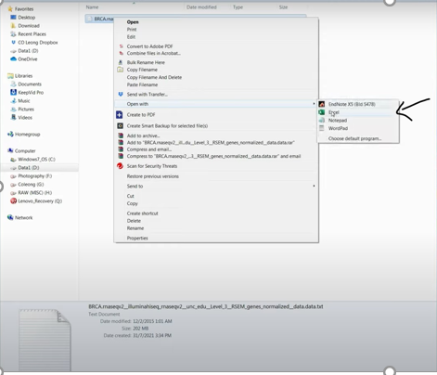
Extract the Data into MS Excel format

Slide 21
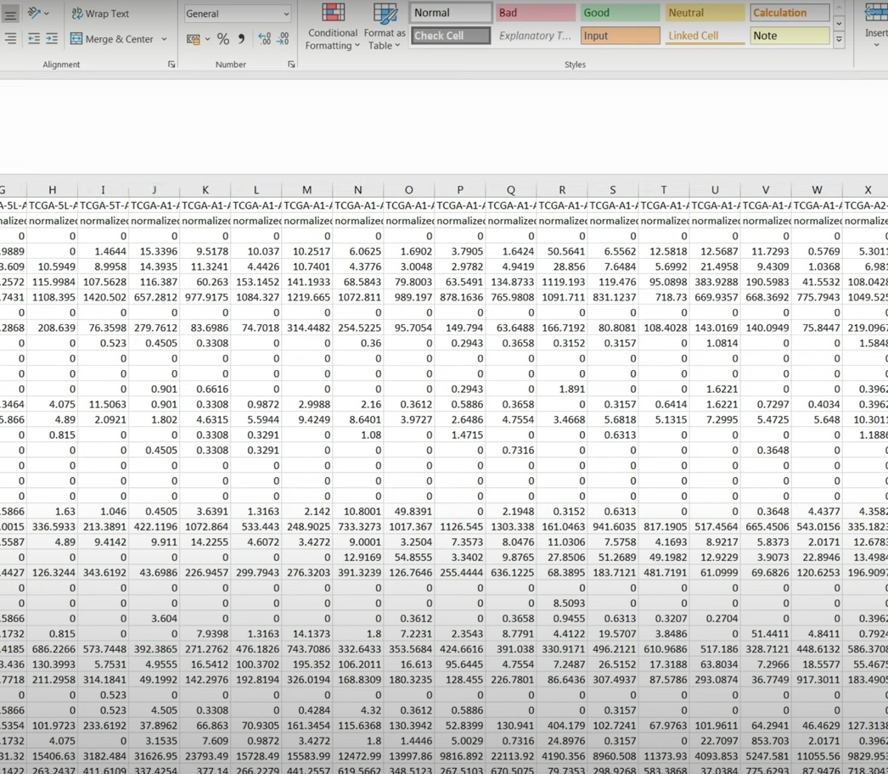
Separate Gene Name and Gene Id

Slide 22
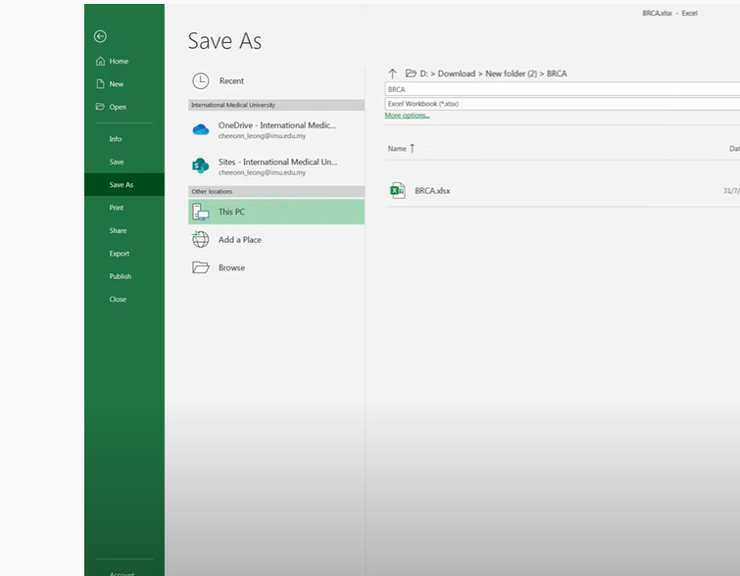
Save as MS Excel format

Slide 23
The Third Tool SurvNet
SurvNet:
is a valuable bioinformatic tool for identifying network-based biomarkers that most correlate with patient survival data. SurvNet takes three input files: one biological network file as the searching platform (several human protein interaction networks are provided as choices), one molecular profiling file (e.g., array-based gene expression or DNA methylation data or mutation data), and one patient survival data file. Given user-defined parameters, SurvNet will automatically identify sub-networks that most correlate with patient survival data and display the results in a visually appealing manner.

Slide 24
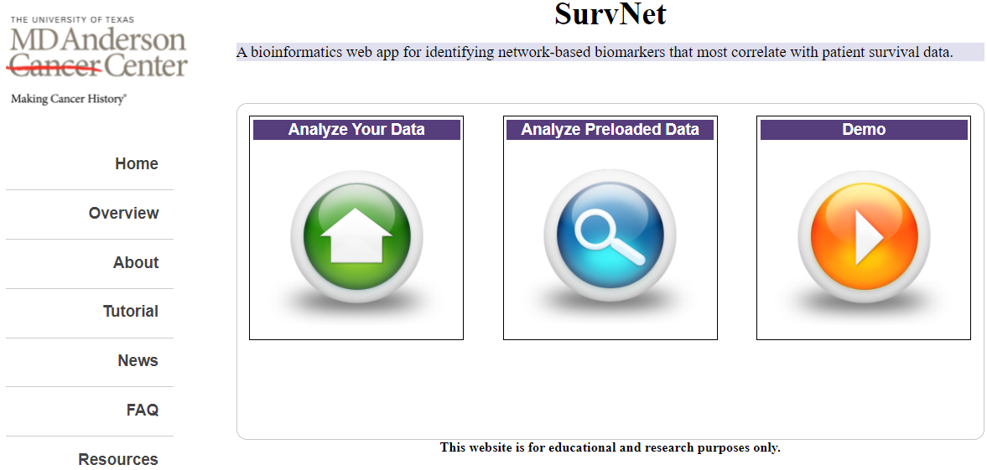
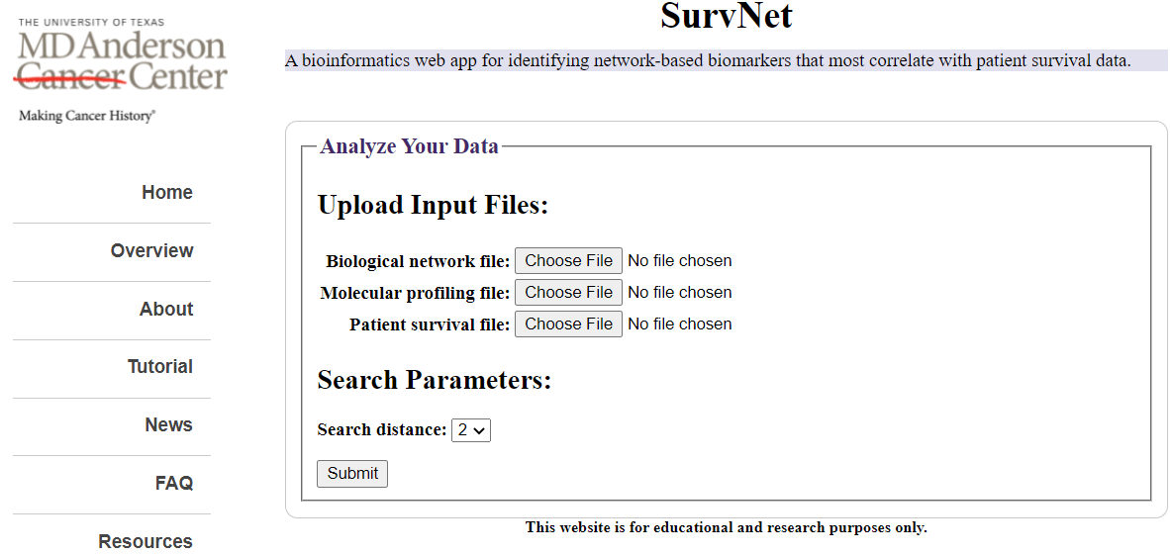

Slide 25
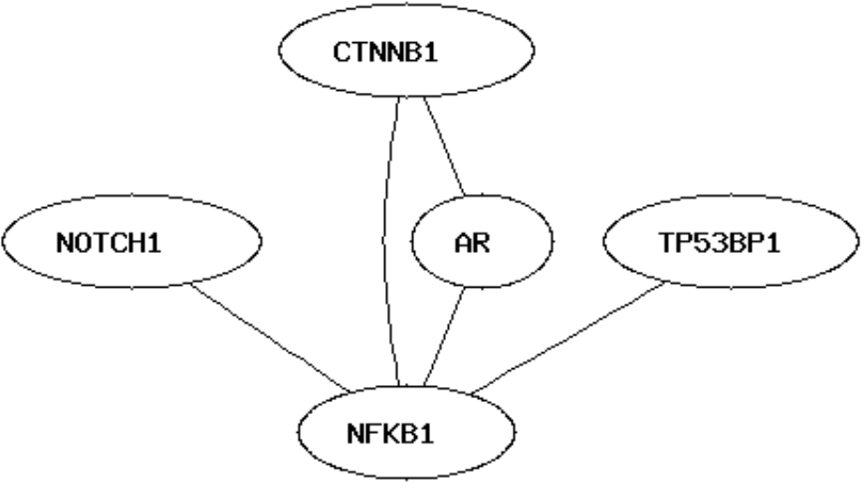
The network data file contains all the edges of a biological network, in which each line has two tab‑separated molecular IDs (protein or gene name) representing two endpoints of an edge. Here is an example of network data and the corresponding network graph.
NOTCH1 NFKB1 NFKB1 AR CTNNB1 AR CTNNB1 NFKB1 TP53BP1 NFKB1

Slide 26
The molecular profiling data (e.g., microarray gene expression data or methylation data) is a tab‑separated numeric matrix, where the column names are the sample IDs and row names are gene IDs. The gene IDs should be consistent with network data, i.e., the same molecules must have identical IDs in both data files. The sample IDs should be the same as the ones in the survival data file. Specifically, the first line of the file has tab‑separated sample IDs. From the second line to the end, the first column contains gene IDs, and the other columns are numeric. For example, N
S1 S2 S3 S4 NOTCH1 0.4 0.2 1.5 1.5 CTNNB1 0.6 0.9 0.5 1.5 TP53BP1 0.5 1.2 2.2 1.5
The survival data has three columns, named "id", "censor", and "time", respectively. The "id" column contains all the sample IDs, which should be the same as what are used in expression data. For the samples who died (censor=1), the corresponding numeric values in the "time" column represent the actual survival time. For the samples who were still alive until the end of the research or were failed to finish the study (censor=0), the time variables are the partial or incomplete survival time. Note: The first line of the data file contains three tab‑separated column names, which should be exactly "id", "censor" and "time".
id censor time S1 0 3.133 S2 1 58.1667 S3 0 60.000 S4 1 17.467

Slide 27
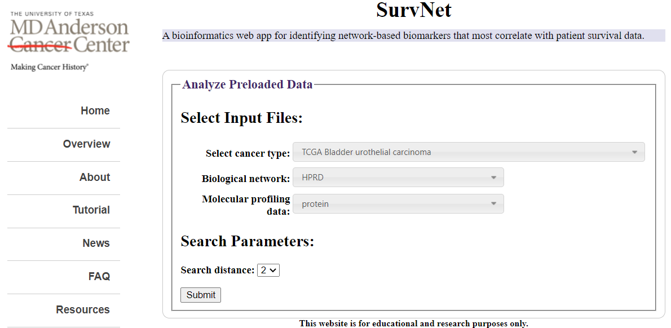
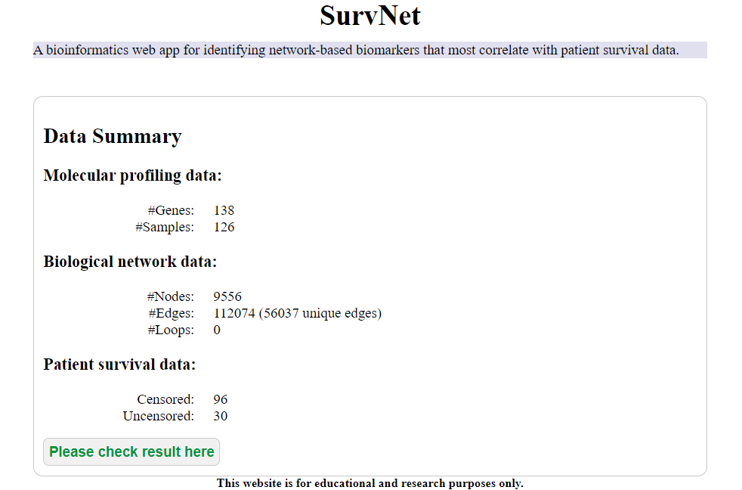
The HPRD is a result of an international collaborative effort between the Institute of Bioinformatics.
HPRD contains manually curated scientific information pertaining to the biology of most human proteins

Slide 28
Analysis of Cancer Genome Atlas in R
We moved on some steps, which are :-
Download the data (clinical and expression) from TGCA.
Processing of the data (normalization) and saving it locally using simple table formats.
Unsupervised analysis includes differential expression, PCA and clustering.
Build a machine learning model (classifier) to predict cancer.
Perform survival analysis of molecular markers detected in previous analysis.

Slide 29

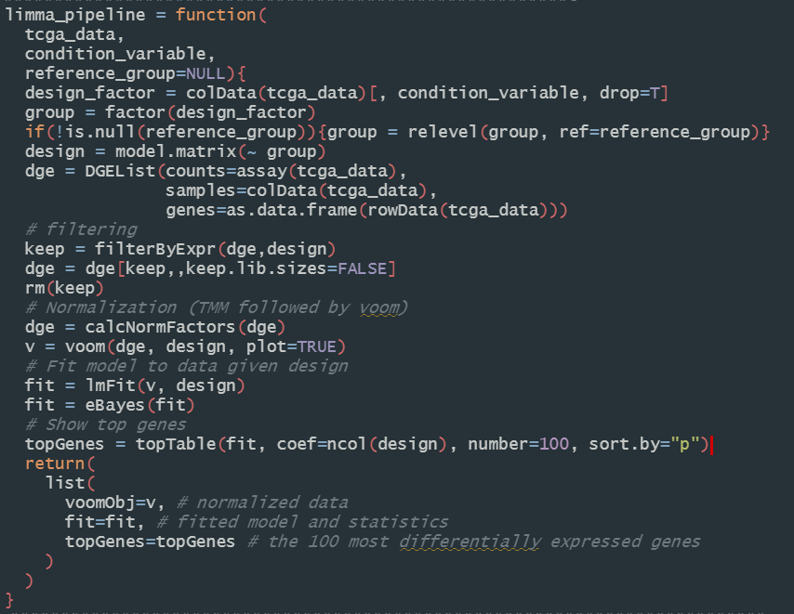
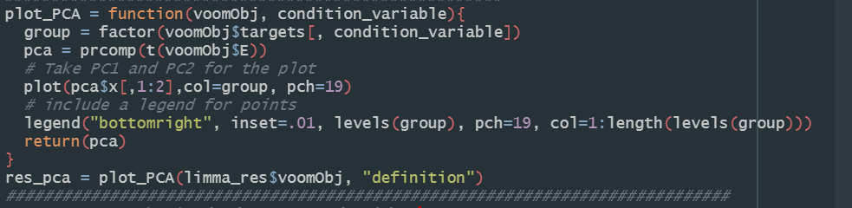
To download TCGA data with TCGAbiolinks, we follow 3 steps. First, query the TCGA database through R with the function GDCquery. This allow us to investigate the data available at the TCGA database. Next, we use GDCdownload to download raw version of desired files into my computer. Finally, GDCprepare will read these files and make R data structures so that we can further analyse them.
A typical task on RNA-Seq data is differential expression (DE) analysis, based on some clinical phenotypes. This, in turn, requires normalization of the data, as in its raw format it may have batch effects and other artifacts.
Before we fit a model to our data, we normalize the data to minimize batch effects and technical variation with the TMM (trimmed mean of M-values) normalization method. Moreover, to apply limma on RNA-seq, we need to convert the data to have a similar variance as arrays. This is done with the VOOM method.
We have also prepared a function that produces PCA plots given the object created by the function. You can inspect this function and try to figure out how it works.
A common approach to such complex tasks is to define a computational pipeline, performing several steps in sequence, allowing the user to select different parameters.

Slide 30
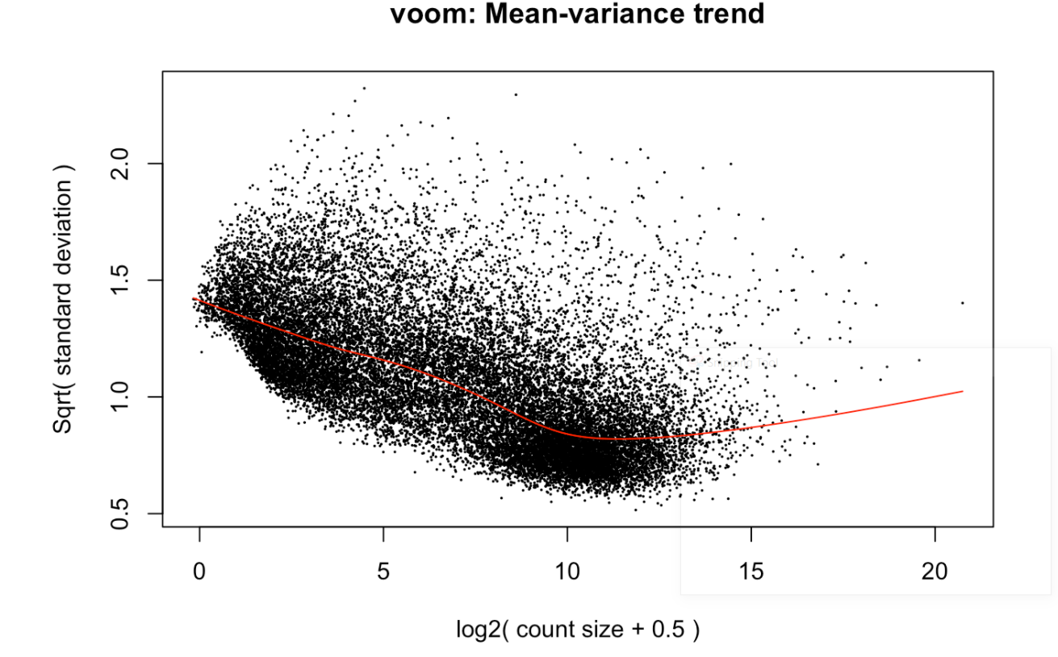
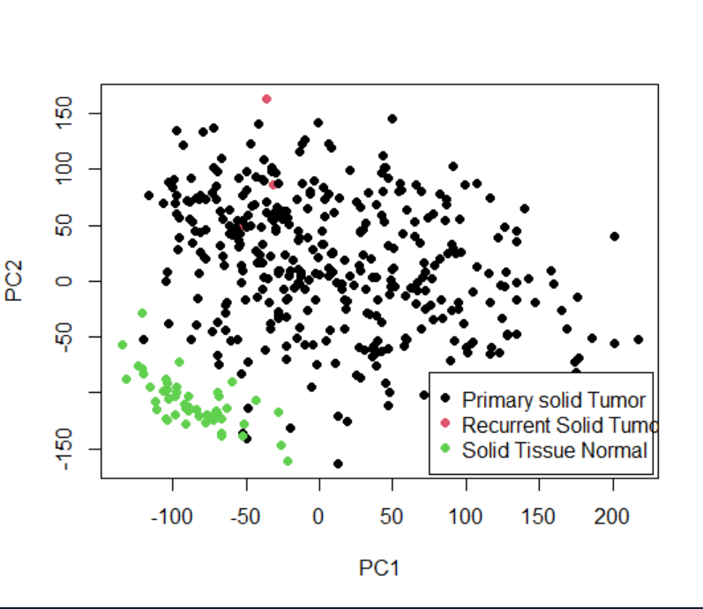
Data After Normalization
Visualization Of Data Using PCA Plot

Slide 31
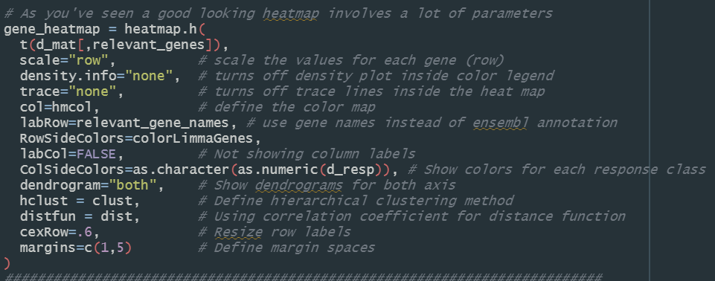
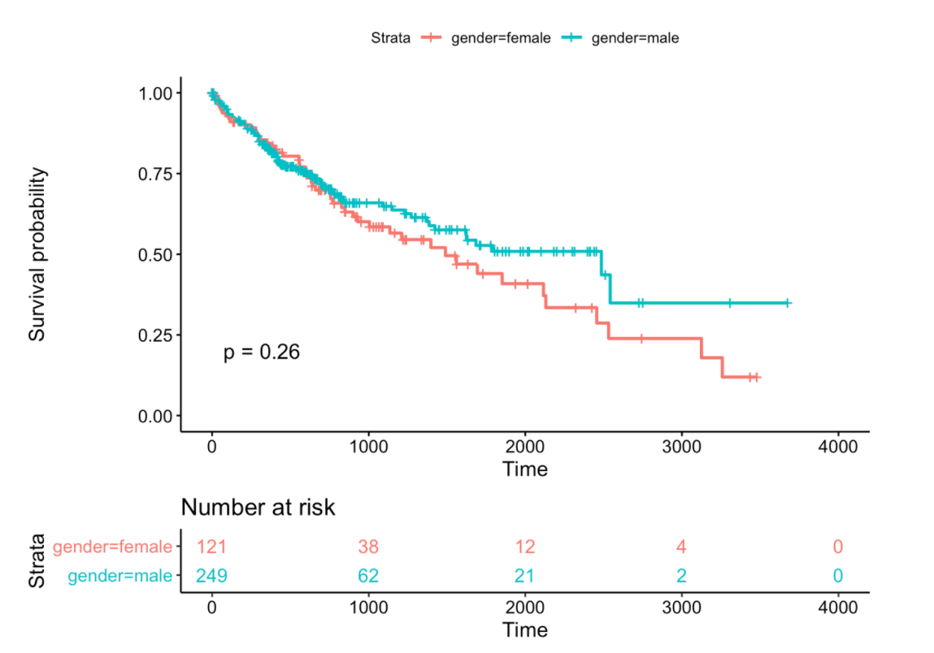
Finally we can take a look at how our samples cluster together by running an hierarchical clustering algorithm. We will only be looking at the genes Elastic Net found and use these to cluster the samples. The genes highlighted in green are the ones that limma had also selected as we’ve seen before. The samples highlighted in red are , the samples highlighted in black are .
One analysis often performed on TCGA data is survival analysis. In short, this boils down to answering the following question: how more likely is a certain group of patients to live longer than another?
To warm up and explain the method, we will start with an easy question: does gender influence survival in liver cancer patients?
You can see that most of the patients die or are censored before the 2000-day mark, and therefore it makes sense that the p-value would not be significant.
Another question could be: how does tumor stage affect survival?

Slide 32
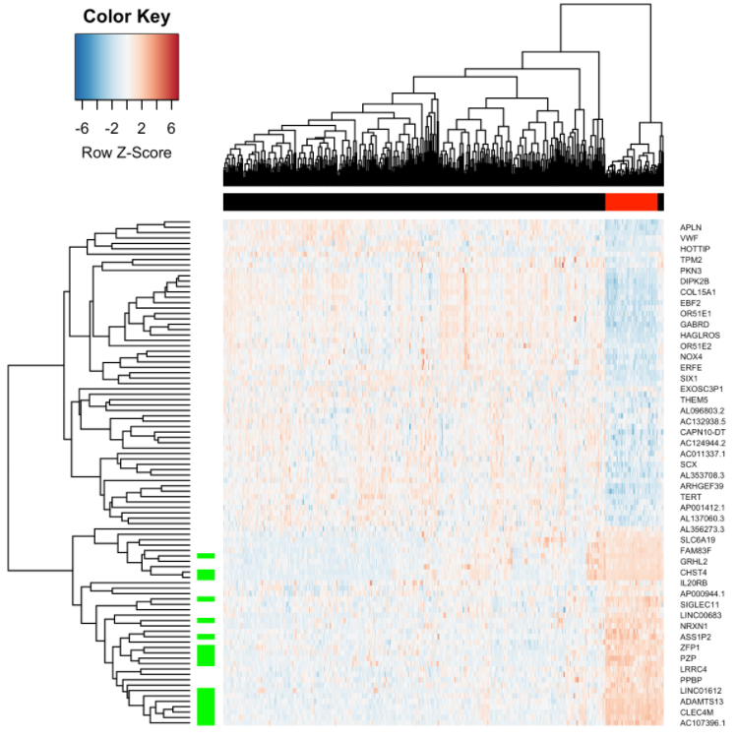
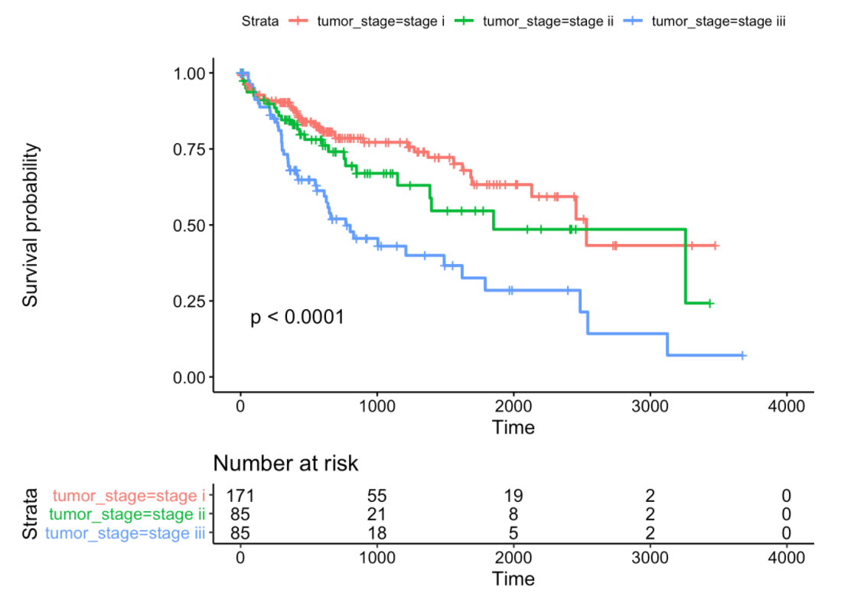
Classification Of Data Using Heatmap
Tumor Stage Affect The Survival
Notes:
library("TCGAbiolinks")
library("limma")
library("edgeR")
library("glmnet")
library("factoextra")
library("FactoMineR")
library("caret")
library("SummarizedExperiment")
library("gplots")
library("survival")
library("survminer")
library("RColorBrewer")
library("gProfileR")
library("genefilter")
GDCprojects = getGDCprojects()
head(GDCprojects[c("project_id", "name")])
TCGAbiolinks:::getProjectSummary("TCGA-LIHC")
query_TCGA = GDCquery(
project = "TCGA-LIHC",
data.category = "Transcriptome Profiling", # parameter enforced by GDCquery
experimental.strategy = "RNA-Seq",
workflow.type = "HTSeq - Counts")
lihc_res = getResults(query_TCGA) # make results as table
head(lihc_res) # data of the first 6 patients.
colnames(lihc_res) # columns present in the table
############################
head(lihc_res$sample_type)
summary(lihc_res$sample_type)
###################################
query_TCGA = GDCquery(
project = "TCGA-LIHC",
data.category = "Transcriptome Profiling", # parameter enforced by GDCquery
experimental.strategy = "RNA-Seq",
workflow.type = "HTSeq - Counts",
sample.type = c("Primary solid Tumor", "Solid Tissue Normal"))
GDCdownload(query = query_TCGA)
tcga_data = GDCprepare(query_TCGA)
dim(tcga_data)
colnames(colData(tcga_data))
table(tcga_data@colData$vital_status)
table(tcga_data@colData$tumor_stage)
table(tcga_data@colData$definition)
table(tcga_data@colData$tissue_or_organ_of_origin)
table(tcga_data@colData$gender)
table(tcga_data@colData$race)
dim(assay(tcga_data))
head(assay(tcga_data)[,1:10])
head(rowData(tcga_data))
saveRDS(object = tcga_data,
file = "tcga_data.RDS",
compress = FALSE)
tcga_data = readRDS(file = "tcga_data.RDS")
########################################################3
limma_pipeline = function(
tcga_data,
condition_variable,
reference_group=NULL){
design_factor = colData(tcga_data)[, condition_variable, drop=T]
group = factor(design_factor)
if(!is.null(reference_group)){group = relevel(group, ref=reference_group)}
design = model.matrix(~ group)
dge = DGEList(counts=assay(tcga_data),
samples=colData(tcga_data),
genes=as.data.frame(rowData(tcga_data)))
# filtering
keep = filterByExpr(dge,design)
dge = dge[keep,,keep.lib.sizes=FALSE]
rm(keep)
# Normalization (TMM followed by voom)
dge = calcNormFactors(dge)
v = voom(dge, design, plot=TRUE)
# Fit model to data given design
fit = lmFit(v, design)
fit = eBayes(fit)
# Show top genes
topGenes = topTable(fit, coef=ncol(design), number=100, sort.by="p")
return(
list(
voomObj=v, # normalized data
fit=fit, # fitted model and statistics
topGenes=topGenes # the 100 most differentially expressed genes
)
)
}
###########################################################################
limma_res = limma_pipeline(
tcga_data=tcga_data,
condition_variable="definition",
reference_group="Solid Tissue Normal"
)
########################################################################
# Save The File
saveRDS(object = limma_res,
file = "limma_res.RDS",
compress = FALSE)
#############################
gender_limma_res = limma_pipeline(
tcga_data=tcga_data,
condition_variable="gender",
reference_group="female"
)
#####################################################
plot_PCA = function(voomObj, condition_variable){
group = factor(voomObj$targets[, condition_variable])
pca = prcomp(t(voomObj$E))
# Take PC1 and PC2 for the plot
plot(pca$x[,1:2],col=group, pch=19)
# include a legend for points
legend("topright", inset=.01, levels(group), pch=19, col=1:length(levels(group)))
return(pca)
}
res_pca = plot_PCA(limma_res$voomObj, "definition")
#############################################################################
# Transpose and make it into a matrix object
d_mat = as.matrix(t(limma_res$voomObj$E))
# As before, we want this to be a factor
d_resp = as.factor(limma_res$voomObj$targets$definition)
# Divide data into training and testing set
# Set (random-number-generator) seed so that results are consistent between runs
set.seed(42)
train_ids = createDataPartition(d_resp, p=0.75, list=FALSE)
x_train = d_mat[train_ids, ]
x_test = d_mat[-train_ids, ]
y_train = d_resp[train_ids]
y_test = d_resp[-train_ids]
x = x_train
y = y_train
res = cv.glmnet(
x,
y ,
alpha = 0.5,
family="binomial"
)
y_pred = predict(res, newx=x_test, type="class", s="lambda.min")
confusion_matrix = table(y_pred, y_test)
# Evaluation statistics
print(confusion_matrix)
print(paste0("Sensitivity: ",sensitivity(confusion_matrix)))
print(paste0("Specificity: ",specificity(confusion_matrix)))
print(paste0("Precision: ",precision(confusion_matrix)))
res_coef = coef(res, s="lambda.min") # the "coef" function returns a sparse matrix
dim(res_coef$`Primary solid Tumor`)
head(res_coef)
res_coef = res_coef[res_coef[,1] != 0,]
# note how performing this operation changed the type of the variable
head(res_coef)
res_coef = res_coef[-1]
relevant_genes = names(res_coef) # get names of the (non-zero) variables.
length(relevant_genes) # number of selected genes
head(relevant_genes)
head(limma_res$voomObj$genes)
relevant_gene_names = limma_res$voomObj$genes[relevant_genes,"external_gene_name"]
head(relevant_gene_names) # few select genes (with readable names now)
print(intersect(limma_res$topGenes$ensembl_gene_id, relevant_genes))
########################################################################################
# define the color palette for the plot
hmcol = colorRampPalette(rev(brewer.pal(9, "RdBu")))(256)
# perform complete linkage clustering
clust = function(x) hclust(x, method="complete")
# use the inverse of correlation as distance.
dist = function(x) as.dist((1-cor(t(x)))/2)
# Show green color for genes that also show up in DE analysis
colorLimmaGenes = ifelse(
# Given a vector of boolean values
(relevant_genes %in% limma_res$topGenes$ensembl_gene_id),
"green", # if true, return green for that value
"white" # if false, return white for that value
)
# As you've seen a good looking heatmap involves a lot of parameters
gene_heatmap = heatmap.2(
t(d_mat[,relevant_genes]),
scale="row", # scale the values for each gene (row)
density.info="none", # turns off density plot inside color legend
trace="none", # turns off trace lines inside the heat map
col=hmcol, # define the color map
labRow=relevant_gene_names, # use gene names instead of ensembl annotation
RowSideColors=colorLimmaGenes,
labCol=FALSE, # Not showing column labels
ColSideColors=as.character(as.numeric(d_resp)), # Show colors for each response class
dendrogram="both", # Show dendrograms for both axis
hclust = clust, # Define hierarchical clustering method
distfun = dist, # Using correlation coefficient for distance function
cexRow=.6, # Resize row labels
margins=c(1,5) # Define margin spaces
)
##########################################################################
# Using the same method as in Day-2, get the dendrogram from the heatmap
# and cut it to get the 2 classes of genes
# Extract the hierarchical cluster from heatmap to class "hclust"
hc = as.hclust(gene_heatmap$rowDendrogram)
# Cut the tree into 2 groups, up-regulated in tumor and up-regulated in control
clusters = cutree(hc, k=2)
table(clusters)
# selecting just a few columns so that its easier to visualize the table
gprofiler_cols = c("significant","p.value","overlap.size","term.id","term.name")
# make sure the URL uses https
set_base_url("https://biit.cs.ut.ee/gprofiler")
# Group 1, up in tumor
gprofiler(names(clusters[clusters %in% 1]))[, gprofiler_cols]
install.packages("gprofiler2")
library("gprofiler2")
########################################################################################
library("TCGAbiolinks")
library("limma")
library("edgeR")
library("glmnet")
library("factoextra")
library("FactoMineR")
library("caret")
library("SummarizedExperiment")
library("gplots")
library("survival")
library("survminer")
library("RColorBrewer")
library("gProfileR")
library("genefilter")
tcga_data = readRDS(file = "tcga_data.RDS")
limma_res = readRDS(file = "limma_res.RDS")
clinical = tcga_data@colData
dim(clinical)
clin_df = clinical[clinical$definition == "Primary solid Tumor",
c("patient",
"vital_status",
"days_to_death",
"days_to_last_follow_up",
"gender",
"ajcc_pathologic_stage")]
# create a new boolean variable that has TRUE for dead patients
# and FALSE for live patients
clin_df$deceased = clin_df$vital_status == "Dead"
# create an "overall survival" variable that is equal to days_to_death
# for dead patients, and to days_to_last_follow_up for patients who
# are still alive
clin_df$overall_survival = ifelse(clin_df$deceased,
clin_df$days_to_death,
clin_df$days_to_last_follow_up)
# show first 10 samples
head(clin_df)
Surv(clin_df$overall_survival, clin_df$deceased)
Surv(clin_df$overall_survival, clin_df$deceased) ~ clin_df$gender
fit = survfit(Surv(overall_survival, deceased) ~ gender, data=clin_df)
print(fit)
fit = survfit(Surv(overall_survival, deceased) ~ gender, data=clin_df)
print(fit)
ggsurvplot(fit, data=clin_df)
ggsurvplot(fit, data=clin_df, pval=T)
ggsurvplot(fit, data=clin_df, pval=T, risk.table=T, risk.table.col="strata")
# remove any of the letters "a", "b" or "c", but only if they are at the end
# of the name, eg "stage iiia" would become simply "stage iii"
clin_df$tumor_stage = gsub("[abc]$", "", clin_df$ajcc_pathologic_stage)
# we remove those with stage "not reported", since they are unknown
clin_df[which(clin_df$tumor_stage == "not reported"), "ajcc_pathologic_stage"] = NA
# finally, we also remove those with tumor stage 4, since they are too few
clin_df[which(clin_df$tumor_stage == "stage iv"), "ajcc_pathologic_stage"] = NA
table(clin_df$tumor_stage)
############################################
######################################
fit = survfit(Surv(overall_survival, deceased) ~ tumor_stage, data=clin_df)
# we can extract the survival p-value and print it
pval = surv_pvalue(fit, data=clin_df)$pval
print(pval)
ggsurvplot(fit, data=clin_df, pval=T, risk.table=T)
# let's extract the table of differential expression we got earlier
expr_df = limma_res$topGenes
# print the first row, to see the gene name, the logFC value and the p-value
print(expr_df[1, ])
# get the ensembl gene id of the first row
gene_id = expr_df[1, "ensembl_gene_id"]
# also get the common gene name of the first row
gene_name = expr_df[1, "external_gene_name"]
# visualize the gene expression distribution on the diseased samples (in black)
# versus the healthy samples (in red)
expr_diseased = d_mat[rownames(clin_df), gene_id]
expr_healthy = d_mat[setdiff(rownames(d_mat), rownames(clin_df)), gene_id]
boxplot(expr_diseased, expr_healthy,
names=c("Diseased", "Healthy"), main="Distribution of gene expression")
# get the expression values for the selected gene
clin_df$gene_value = d_mat[rownames(clin_df), gene_id]
# find the median value of the gene and print it
median_value = median(clin_df$gene_value)
print(median_value)
# divide patients in two groups, up and down regulated.
# if the patient expression is greater or equal to them median we put it
# among the "up-regulated", otherwise among the "down-regulated"
clin_df$gene = ifelse(clin_df$gene_value >= median_value, "UP", "DOWN")
# we can fit a survival model, like we did in the previous section
fit = survfit(Surv(overall_survival, deceased) ~ gene, data=clin_df)
# we can extract the survival p-value and print it
pval = surv_pvalue(fit, data=clin_df)$pval
print(pval)
# and finally, we produce a Kaplan-Meier plot
ggsurvplot(fit, data=clin_df, pval=T, risk.table=T, title=paste(gene_name))

Slide 33

Our Team
Randa Adel
Randa Sabry
Reham Refaat
Habiba Adnan
Rania Sultan
Sara Ahmed Mohammed Sobhy

Slide 34
Thank you

